Slide 1
reclaiming Christianity For Seekers and newcomers
A model developed by bishop claude payne
Reclaiming Christianity

Slide 2
Theology
Spiritual treasure is stored in our souls and encompasses all past encounters or perceptions of the divine from our birth to the present
Christ is our source of spiritual power and guidance and is the Church’s greatest asset
The Church is God’s vehicle for identifying and nurturing this source, blessing those who build upon it and directing them to bless others
The Jesus Movement is our expression of this mission
Christianity is caught and then taught, so not a “talking head” model and many different presenters, discussion-based
Many Christians are well-equipped with spiritual treasure, but need nurture for recognition and sharing
The goal is to equip individual seekers for a pilgrimage through life and into eternity

Slide 3
Current Setting
Christianity, especially the westernized part, is in decline in number and influence—offers huge missionary opportunity
Christian Formation—the formation of new and renewed Christians- is at the heart of recovery
Team structure—clergy and laity with sharing of spiritual disciplines and faith stories at its core
Formation is most powerfully done locally and in a team setting, utilizing peer engagement led by a Christian Formation team of clergy and trained laity
“A team can far better deliver basic Christianity than can a pastor teaching alone, for a newcomer’s needs are on many levels. When they find their longings and needs addressed, their joy skyrockets and their gratitude soars” (Bishop Payne).
For newcomers and current members!

Slide 4
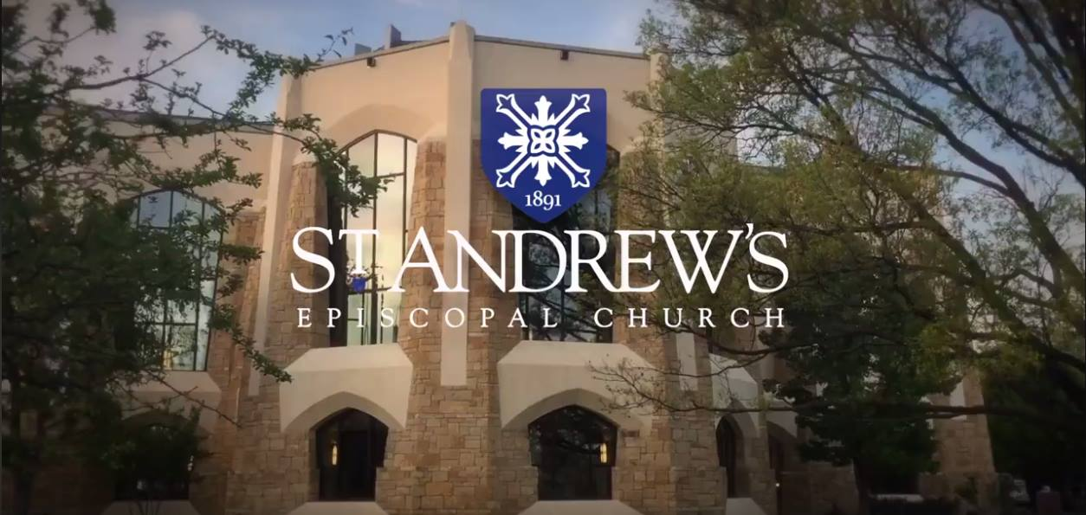
Model began In Abilene, but is moving outward…and building
The model has been tested at the Church of the Heavenly Rest, Abilene in the Diocese of Northwest Texas (2 sessions yearly for 4 years)—Named “New Member Formation”
Heavenly Rest “spreads the love” by hosting training conferences.
St. Andrew’s has followed the model since Spring 2018—named our class “Seekers and Newcomers”
We follow a Spring and Fall class model (only taking off in the Summer)… finding it important to always have a class to invite visitors, seekers, and newcomers to come to.
Not about numbers, but… before we adopted the model, confirmed/received 7-10 a year. In 2018, we had 22 confirmed/received (6 reaffirmed); 2019, 21 confirmed/received (7 reaffirmed).

Slide 5
Class Sessions
Breakfast! Greeting time
Begin with prayer- leader of the day leads the class in prayer (usually from BCP)
Leader introduces “the question” for the day.
Examples of questions: What role has the Bible played in your life? How do the Holy Scriptures attract or discourage you? Why do you pray? What is your experience of prayer? What is your experience with Holy Eucharist? How does it affect your life?
10 minute table discussion
2-3 minute introduction of speaker by Clergy or Table Mentor
30 minute presentation, including the presenters sharing their own spiritual treasure
10-15 minute wrap-up at table

Slide 6
Breakfast!!

Slide 7
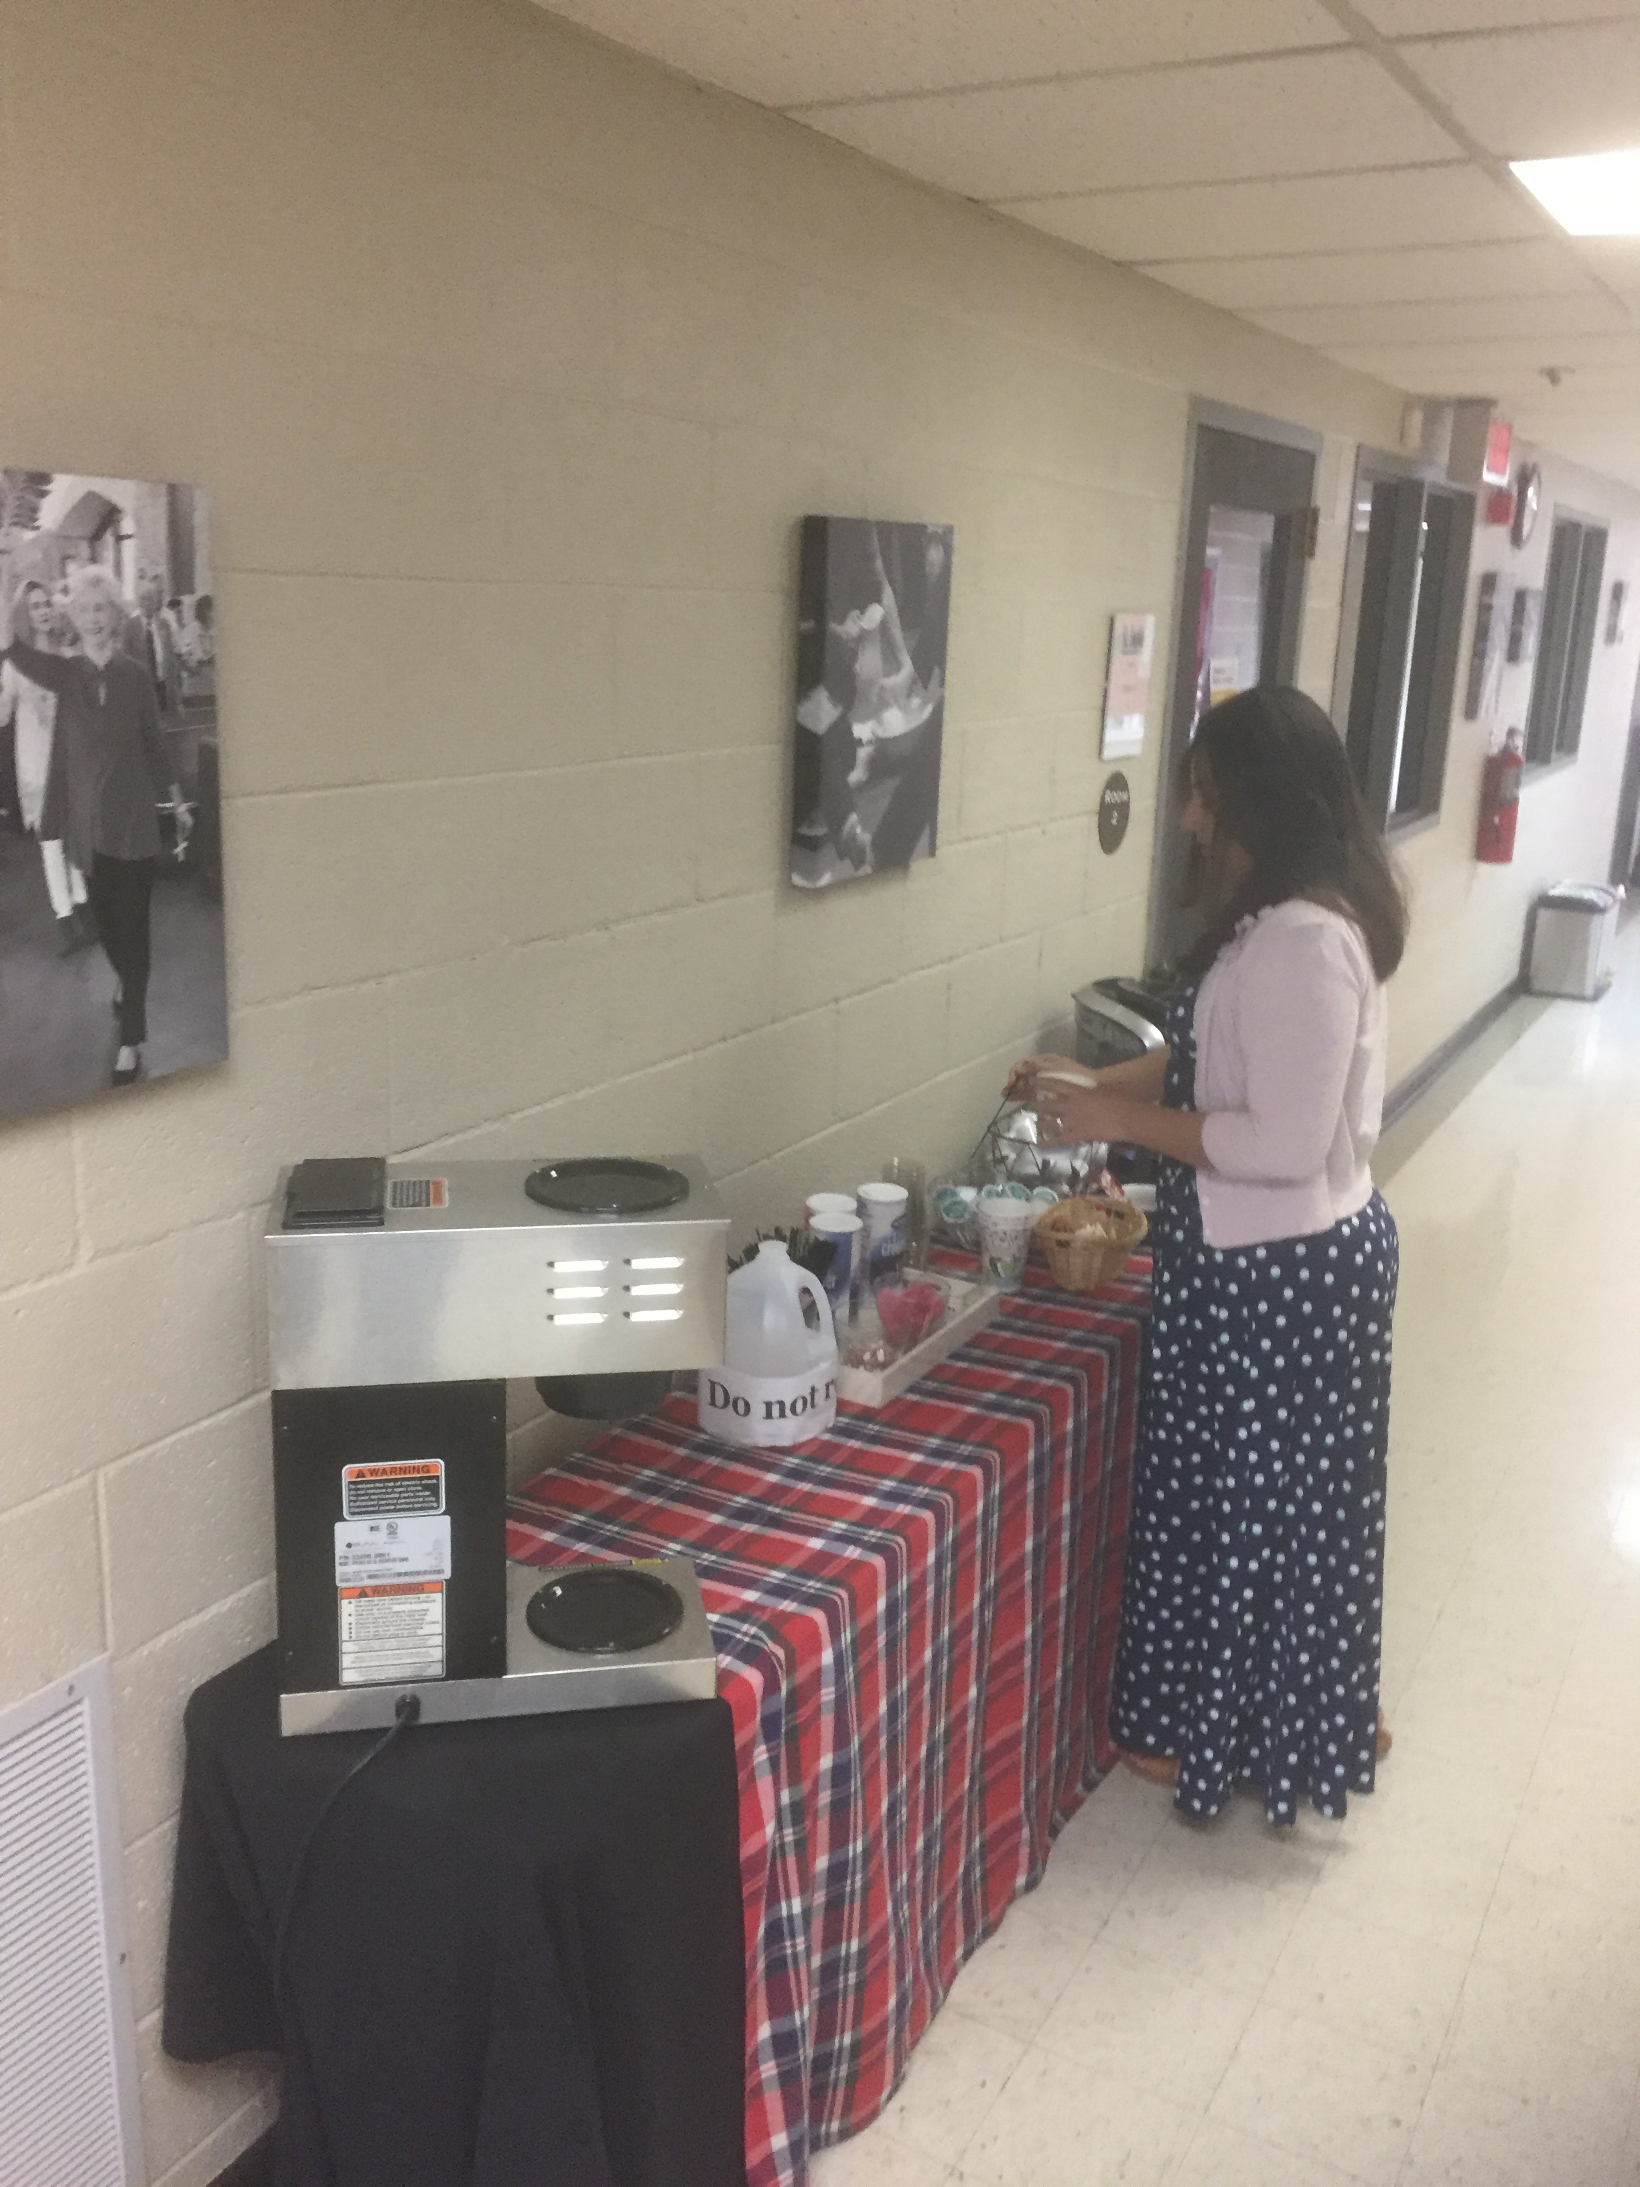
Coffee Bar (Just Outside Classroom)

Slide 8
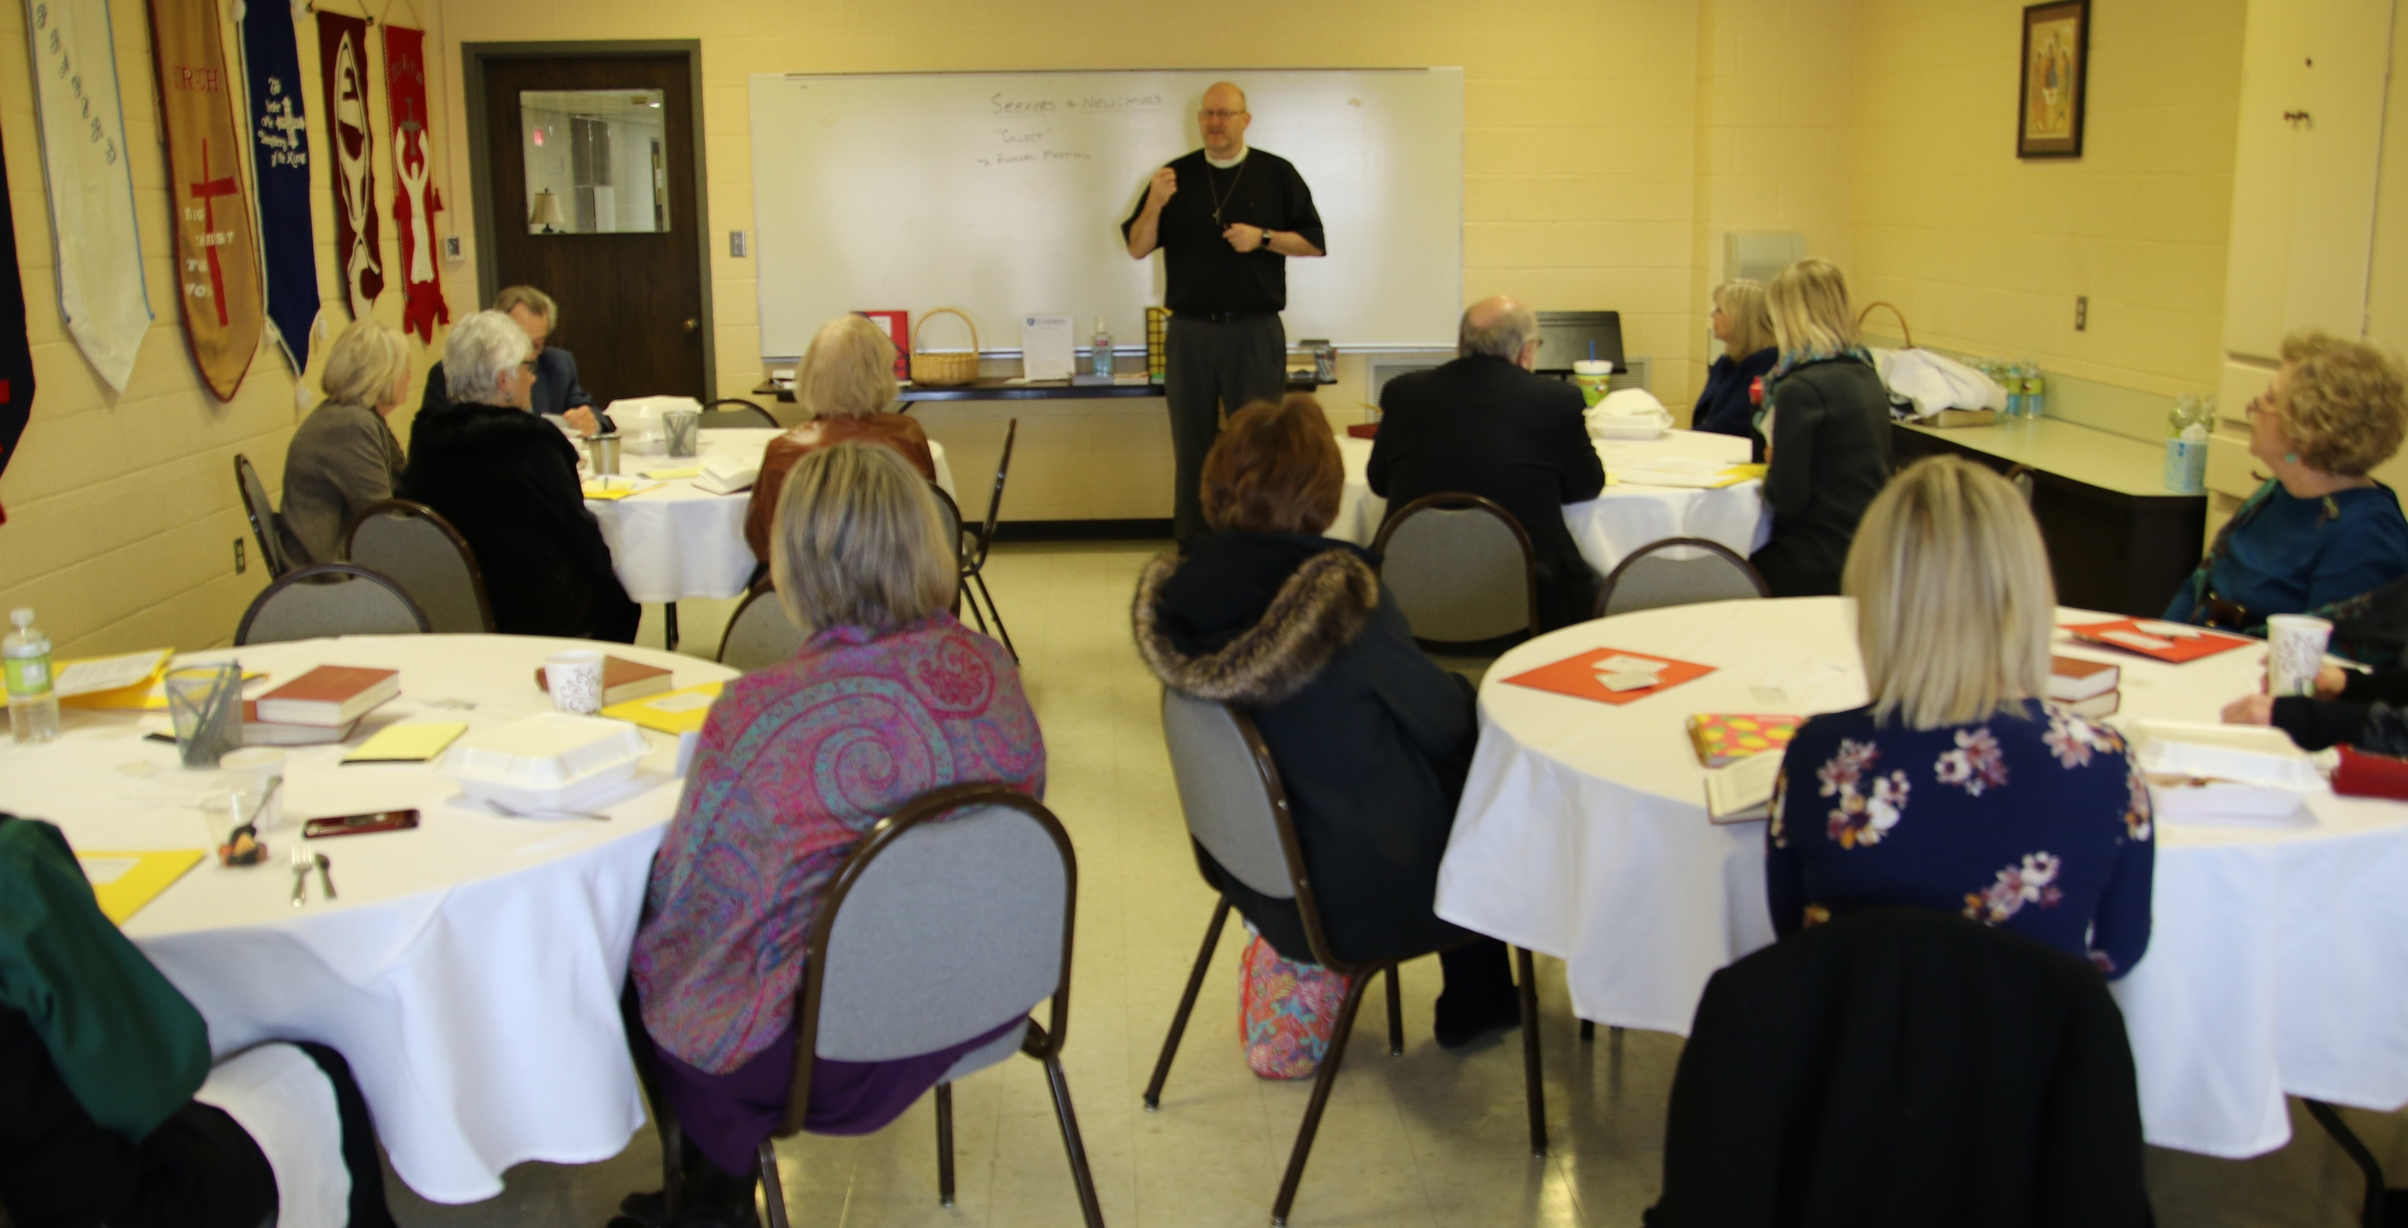

Slide 9
Table Arrangement

Slide 11
Infrastructure for evangelism
This model helps build infrastructure for reaching out to others in the love of Christ
We have infrastructure for worship—choir, acolytes, altar guild, ushers, etc.; but we don’t always have infrastructure for evangelism
This is a method for engaging people with the local body of Christ. For some it may lead to confirmation, baptism, or reception. For some it may be a continued time of discernment about their role within the Church. Seeking of confirmation, baptism, or reception is not a requirement for attending. Many of our current church members love to attend this class for connection, understanding, and deepening of their faith—some choose reaffirmation.
Sets up a way to have proximity with others—hear each others’ stories/spiritual treasure
A delineated way to invite others into our midst as a worshiping community

Slide 12
St. Andrew’s Visitor
Flow Chart
Visitors Attend or Inquire
Mentors Assigned to Call/Text/Email
Clergy and Hospitality Coordinator Informed
Invited to Seekers and Newcomers Class
Church Secretary
Data Entry and Letter Sent
Connected to Ministries

Slide 13
Team Structure for class
Co-coordinators—one clergy, one lay (the ideal)
Spiritual Directors—clergy
Hospitality Coordinator—extroverted, organized, welcoming, willing to coordinate inviting people to class
Church Secretary—organized; gathers data of new inquiries and enters into database; sends letter to visitor/newcomer; sends contact info to mentors for further communication each week.
Table mentors—lay people, trained to facilitate discussion; willing to make contact with new inquiries and follow up with current attendees; train more than the number needed to cover absences
Greeters—table mentors rotate each Sunday to greet people and help them sign in and get name tags, help people find a seat, welcome/hospitality
Commitment—one training session per “semester“ (covers theology, Spiritual Treasures, logistics), weekly class participation, weekly meetings; perception of asking this much vs. the reality; mentors are asked to commit to one semester at a time (some have stayed mentors since the beginning)
Effect on the team members—incredible spiritual growth!

Slide 14
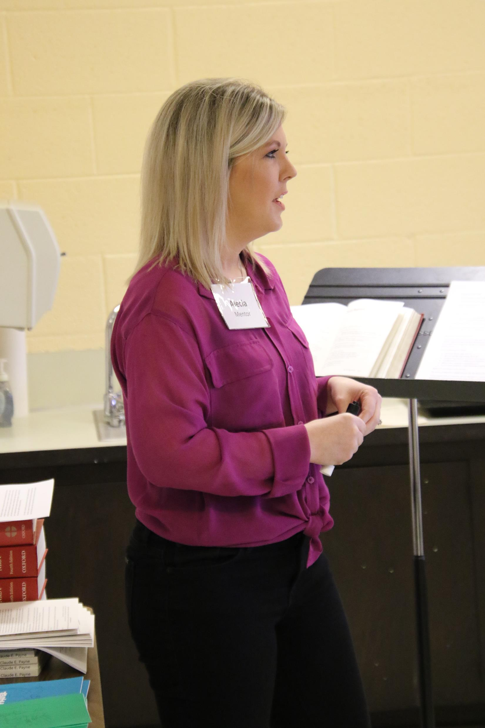
Talks
Speakers come from the congregation/community—Everyone has spiritual treasures… .
Sharing of spiritual treasure is key
Speakers invited by the clergy to participate (need to help individual speakers discern which topics are their gifts…)
Clergy also speakers on some topics—but also must speak from the heart…share spiritual treasures.
The temptation for all is to be too informational… This is JUST NOT ABOUT SHARING INFORMATION… It’s about opening our hearts and showing Christ.

Slide 15
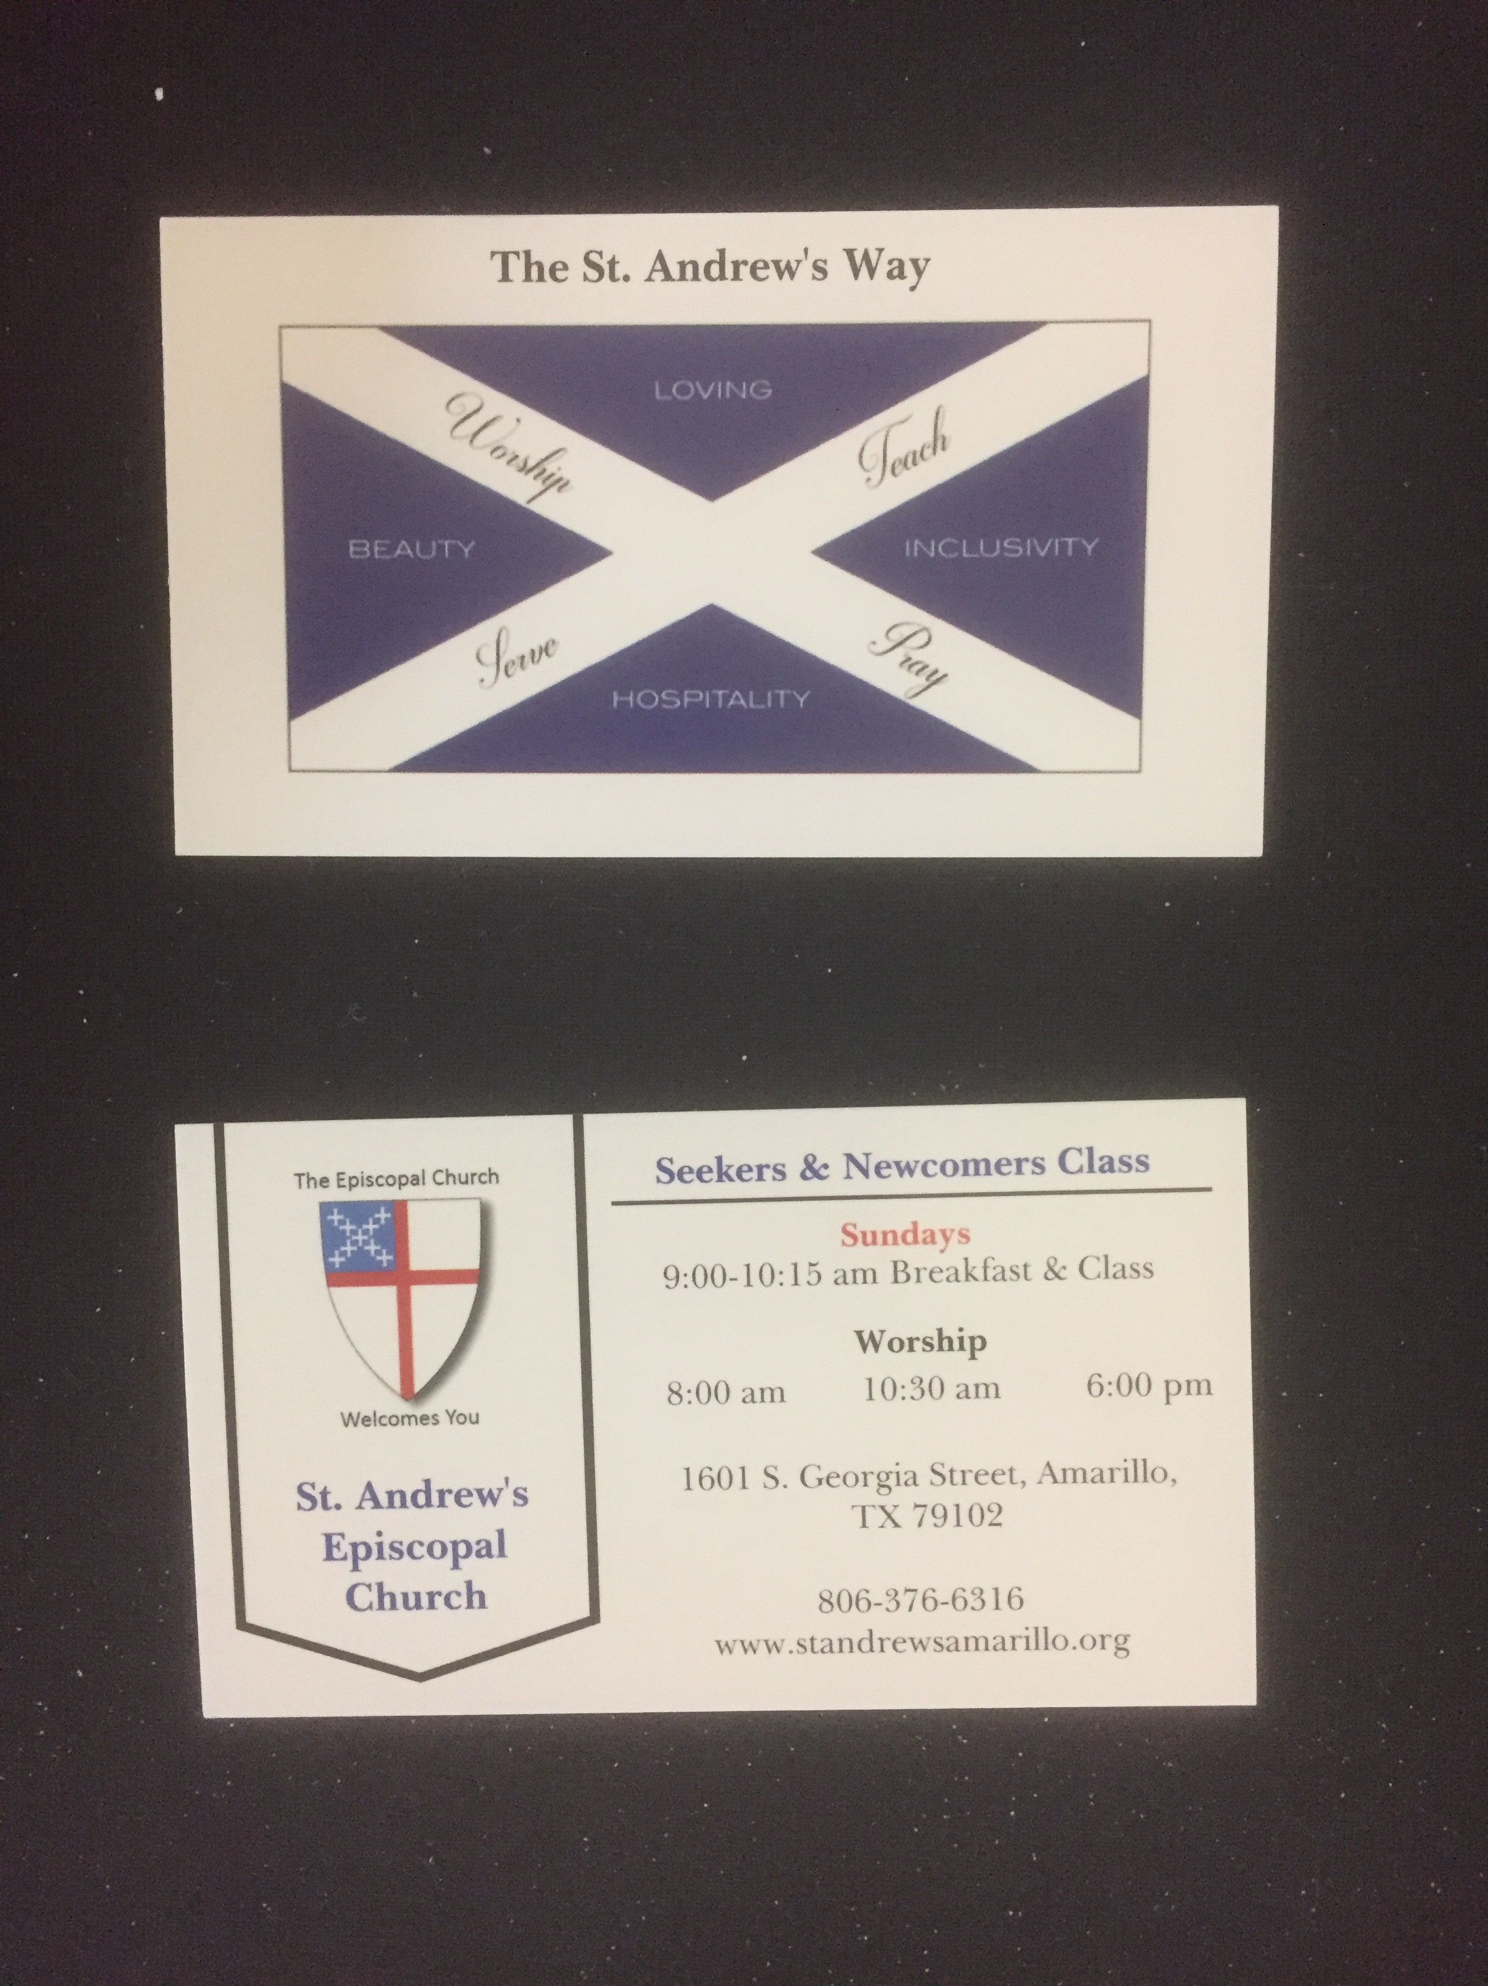
CARDS!!! (Front and BAcK)
Cheap, Cheap, Cheap to make
Easy to hand out EVERYWHERE!!!
Church identity statement (who we are).
Time of the Seekers and Newcomers Class
Worship times
Address, phone number, web address…

Slide 16
Model is used in various congregations
Heavenly Rest, Abilene- program size parish
St. Andrew’s, Amarillo- program size parish
St. Stephen’s, Lubbock- pastoral size parish
St. Stephen’s, Sweetwater and All Saint’s, Colorado City—yoked family size parishes, Wednesday night meetings in 4-week series at Argos bookstore/pub in Sweetwater, TX
Holy Spirit, Lake Forest, IL—resource size parish
2 other congregations in Diocese of Northwest Texas currently learning the model

Slide 17
Reflections
This model of spiritual formation is a gift. Ancient yet fresh, deep yet accessible; it mines the priceless treasures of the Christian faith yet is hospitable to all walks of life. On Wednesday nights we gather at a brewhouse on the town square, but our thirst is quenched by more than the local brew. We get to drink from the hidden spring that runs through our life with God and one another and we always leave thirsting for more. I cannot think of a greater joy than to witness people grow in the love and knowledge of God and watch them invite others to such a growth as well. I am grateful for this Reclaiming Christianity model and how God continues to work through it in these two little mission churches in small town West Texas. – Rev. Jared Houze, vicar St. Stephen’s, Sweetwater and All Saint’s, Colorado City

Slide 18
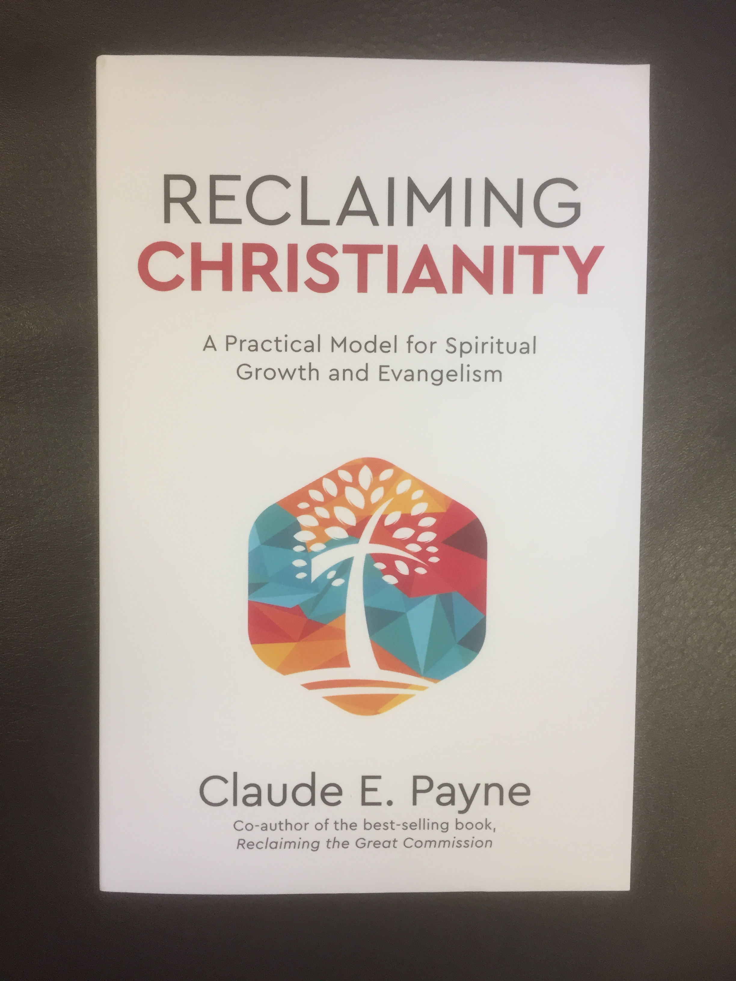
Resources
Bishop Payne’s Book Reclaiming Christianity, specifically chapters 1-3
St. Andrew’s Episcopal Church, Amarillo, TX— The Rev. Jill Walters
The Church of the Heavenly Rest, Abilene, TX—The Rev. Claire Makins

